Slide 1


Situational Leadership
®
®

Slide 2

A note on Situational Leadership
  Developed by Dr. Paul Hersey and Dr. Ken Blanchard in the late 1960's.
  Their paths crossed at a conference where Hersey was speaking.
  They pulled ideas from other the theories popular at that time.
  They jointly published a ground breaking book in 1969 "Management of Organizational Behavior: Utilizing Human Resources."

Slide 3

Today's Agenda
  Understand the characteristics of a Situational Leader.
  Know how to diagnose your follower's development needs.
  Learn the three leadership skills that you need to master.
  Be able to diagnose a situation and determine the best style.
  Know how to effectively use Situational Leadship to manage your staff.

Slide 4

So what is leadership?
Please type in the comment section one word that you think best describes leadership.

Slide 5
Leadership Defined:
An influence process; working with and through others to accomplish the goals of the organization

Slide 6
The Purpose of Leadership Training
To increase the quality of the time you spend with the people
you manage

Slide 7
Leadership Style
Your pattern of behaviors as others see you, not how you see yourself

Slide 8

Performance and Satisfaction
Different Sides of the Same Coin
PERFORMANCE
SATISFACTION

Slide 9

Discretionary Performance
EMPLOYEE
100 %
80 to 90 percent
Area Affected
by Proper Leadership Styles
Percentage of Ability
20 to 30 percent
0 %

Slide 10
Situational Leadership
Case Study #1
Scen﻿ario: Your company has recently introduced a new production process that requires strict adherence to safety protocols. Mike, one of the experienced production workers, is struggling to adapt to the new process and frequently overlooks safety guidelines, putting himself and others at risk.
Possible Answers:
  Conduct a disciplinary action against Mike to set an example for others.
  Assign a mentor to guide Mike through the new production process.
  Offer additional training to enhance Mike's understanding of the safety protocols.
  Remove Mike from the production process and assign him to a different role.

Slide 11
LEADER BEHAVIOR
(HIGH)
DIRECTIVE BEHAVIOR-
the extent to which the leader engages in defining roles, telling what, how, when, where, and if more than one person, who’s to do what in:
  Goal Setting
  Organizing
  Establishing Time Lines
  Directing
  Controlling
(LOW)
Directive Behavior
(HIGH)

Slide 12
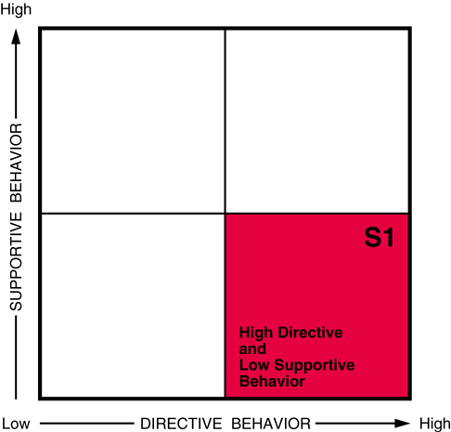
Key Words for Directive Behavior
• Structure
• Organize
• Teach
• Supervise
• Evaluate

Slide 13
Directive Behavior
The extent to which a leader …
  Sets goals and clarifies expectations
  Tells and shows an individual what to do, when, and how to do it
  Closely supervises, monitors, and evaluates performance

Slide 14
LEADER BEHAVIOR
SUPPORTIVE BEHAVIOR-
the extent to which a leader engages in two-way (or multi-way) communication, listening, facilitating behaviors, socio-emotional support
This entails:
  Giving Support
  Communicating
  Facilitating Interactions
  Active Listening
  Providing Feedback
(HIGH)
Supportive Behavior
(LOW)
Directive Behavior
(HIGH)

Slide 15
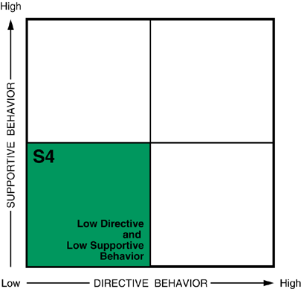
Key Words for Supportive Behavior
• Ask (for input)
• Listen
• Facilitate (problem solving)
• Explain (why)
• Encourage

Slide 16
Supportive Behavior
The extent to which a leader …
  Engages in more two way communication
  Listens and provides support and encouragement
  Involves the other person in decision making
  Encourages and facilitates self-reliant problem solving

Slide 17
LEADER BEHAVIOR
SUPPORTIVE BEHAVIOR-
the extent to which a leader engages in two-way (or multi-way) communication, listening, facilitating behaviors, socio-emotional support
This entails:
  Giving Support
  Communicating
  Facilitating Interactions
  Active Listening
  Providing Feedback
(HIGH)
DIRECTIVE BEHAVIOR-
the extent to which the leader engages in defining roles, telling what, how, when, where, and if more than one person, who’s to do what in:
  Goal Setting
  Organizing
  Establishing Time Lines
  Directing
  Controlling
Supportive Behavior
(LOW)
Directive Behavior
(HIGH)

Slide 18
LEADER BEHAVIOR
SUPPORTIVE BEHAVIOR-
the extent to which a leader engages in two-way (or multi-way) communication, listening, facilitating behaviors, socio-emotional support
This entails:
  Giving Support
  Communicating
  Facilitating Interactions
  Active Listening
  Providing Feedback
(HIGH)
DIRECTIVE BEHAVIOR-
the extent to which the leader engages in defining roles, telling what, how, when, where, and if more than one person, who’s to do what in:
  Goal Setting
  Organizing
  Establishing Time Lines
  Directing
  Controlling
Style 3
Style 2
Supportive Behavior
Style 4
Style 1
(LOW)
Directive Behavior
(HIGH)

Slide 19

Flexibility
The ability to use a
variety of leadership styles

Slide 20
Leader Behavior
In all 4 styles, the leader:
  sets goals
  observes and monitors performance
  provides feedback

Slide 21
Leader Behavior
The 4 styles vary in 3 ways:
  the amount of direction the leader provides
  the amount of support the leader provides
  the amount of follower involvement in decision-making

Slide 22
Effectiveness: How do you know which style to use?
Look at the situational variables
  my boss’s style
  corporate culture
  amount of change in the organization

Slide 23
Effectiveness: How do you know which style to use?
Look at the task variables
  importance of the task
  complexity of the task
  timeliness

Slide 24
Effectiveness: How do you know which style to use?
Look at other variables
  Leader’s preferred style
  Follower’s development level

Slide 25
Diagnosis
The ability to assess an employee's development level with regard to
the task at hand

Slide 26
Development Levels Defined
Competence Commitment

Slide 27
Development Levels Defined
Competence
  task relevant knowledge
  transferable skills

Slide 28
Development Levels Defined
Commitment
  motivation
  confidence

Slide 29
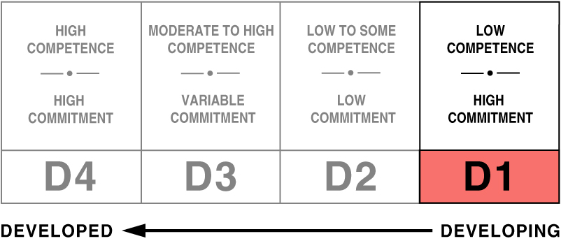
Development Level 1

Slide 30
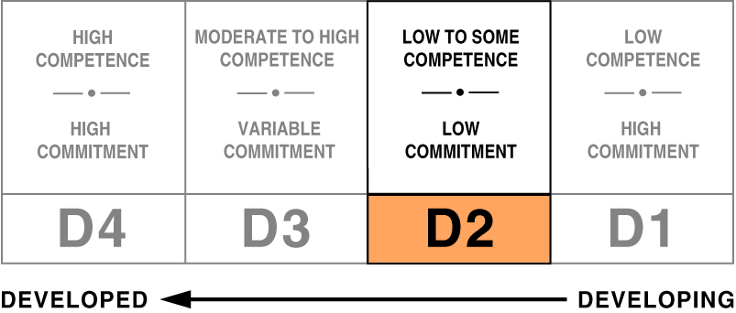
Development Level 2

Slide 31
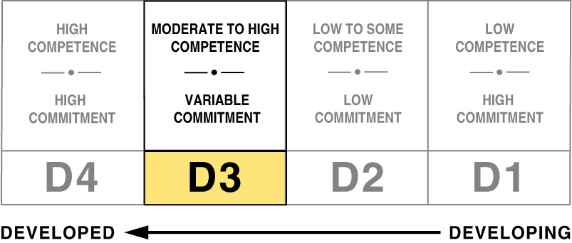
Development Level 3

Slide 32
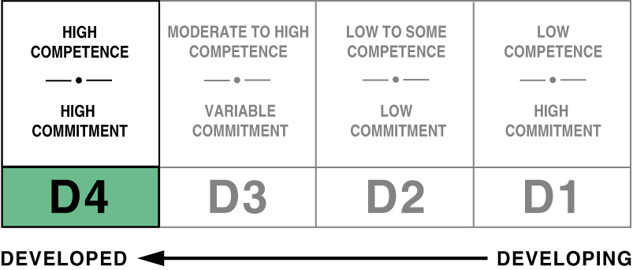
Development Level 4

Slide 33
Development Stages
Stage 1 - Enthusiastic Beginner
Stage 2 - Disillusioned Learner
Stage 3 - Emerging Contributor
Stage 4 - Peak Performer

Slide 34
The Four Development Stages
Emerging Contributor
Supporting
Disillusioned Learner Coaching
3
2
4
1
Peak Performer Delegating
Enthusiastic Beginner Directing

Slide 35
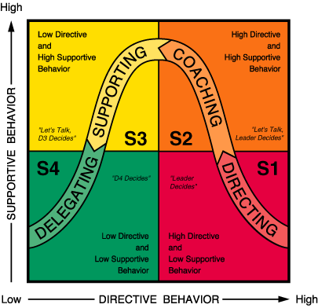
The Four Leadership Styles

Slide 36
Hints on defining
Development Levels
  Be “TASK SPECIFIC”
  Focus on demonstrated skills (not “should be able to” or “used to”)
  Question is “are they” not “can they”
  Respond to follower's needs -vs- wants
  Don’t confuse enthusiasm for ability
  Avoid diagnosing insecurities as unmotivated
  Impacting knowledge doesn’t guarantee skill

Slide 37
In general,
the more time you spend with your people,
the less effective
you are.

Slide 38
Doing for your people what they can’t do for themselves

Slide 39
Effective leaders use different strokes for different folks

Slide 40
Effective leaders use different strokes for the same folks depending on the task

Slide 41
Situational Leadership
Case Study #1
Scen﻿ario: Your company has recently introduced a new production process that requires strict adherence to safety protocols. Mike, one of the experienced production workers, is struggling to adapt to the new process and frequently overlooks safety guidelines, putting himself and others at risk.

Slide 42
Situational Leadership
Case Study #1
Scen﻿ario: Your company has recently introduced a new production process that requires strict adherence to safety protocols. Mike, one of the experienced production workers, is struggling to adapt to the new process and frequently overlooks safety guidelines, putting himself and others at risk.
Best Alternative: Answer 3
Offer additional training to enhance Mike's understanding of the safety protocols. With a directive leadership style, providing clear instructions and training is essential. In this case, offering targeted training will help Mike understand the importance of safety and ensure compliance with the new production process.

Slide 43
Situational Leadership
Case Study #2
Scenario: Your company is launching a new product line that requires collaboration between different departments. The team members are experienced and have successfully handled similar projects in the past.
Possible Answers:
  Assign specific tasks to individual team members based on their expertise.
  Provide detailed instructions and guidelines for the new product launch.
  Oversee all aspects of the project to ensure seamless coordination.
  Let the team members decide how to allocate tasks and coordinate the project.

Slide 44
Situational Leadership
Case Study #2
Scenario: Your company is launching a new product line that requires collaboration between different departments. The team members are experienced and have successfully handled similar projects in the past.
Best Alternative: Answer 4
Let the team members decide how to allocate tasks and coordinate the project. With a delegating leadership style, you trust the expertise of your team and let them take ownership of the project. This approach fosters creativity, collaboration, and a sense of responsibility among team members, leading to a successful product launch.

Slide 45
Situational Leadership
Case Study #3
Scen﻿ario: Your company is facing a sudden surge in demand for its products. The production team is working overtime, and fatigue is affecting their productivity and overall morale.
Possible Answers:
  Introduce performance bonuses to encourage the team to meet the increased demand.
  Provide the team with additional resources to streamline production.
  Offer the team frequent breaks and incentives to keep their spirits high.
  Adjust the production schedule to reduce the workload and relieve fatigue.

Slide 46
Situational Leadership
Case Study #3
Scen﻿ario: Your company is facing a sudden surge in demand for its products. The production team is working overtime, and fatigue is affecting their productivity and overall morale.
Best Alternative: Answer 4
Adjust the production schedule to reduce the workload and relieve fatigue. In a supporting leadership style, it's essential to prioritize the well-being of the team. By adjusting the production schedule, you can alleviate the pressure on the team, promote work-life balance, and maintain their productivity in the long run.

Slide 47
Situational Leadership
Case Study #4
Scen﻿ario: Your company is implementing new quality control measures to improve product standards. Emma, a quality control supervisor, has a lot of experience and knowledge but is resistant to the changes and prefers the old methods.
Possible Answers:
  Reprimand Emma for resisting the new quality control measures.
  Offer Emma incentives or rewards to embrace the new measures.
  Have a one-on-one conversation with Emma to understand her concerns and address them.
  Ignore Emma's resistance and focus on motivating other employees to adopt the changes.

Slide 48
Situational Leadership
Case Study #4
Scen﻿ario: Your company is implementing new quality control measures to improve product standards. Emma, a quality control supervisor, has a lot of experience and knowledge but is resistant to the changes and prefers the old methods.
Best Alternative: Answer 3
Have a one-on-one conversation with Emma to understand her concerns and address them. In a coaching leadership style, it's crucial to provide support and guidance to employees during transitions. By having an open and empathetic conversation with Emma, you can help her see the benefits of the new quality control measures and address any concerns she may have.

Slide 49
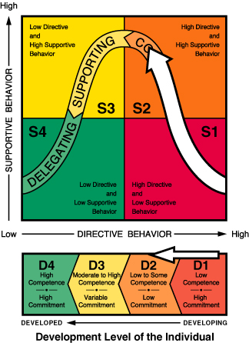
The Development Cycle

Slide 50
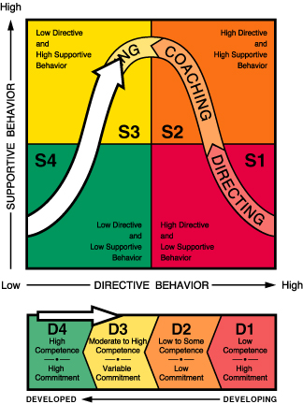
The Regressive Cycle

Slide 51

Reference Material

Slide 52

Additional Resources
  Reading list for managers and executives
  Reading list for middle managers and supervisors
  Bob's Blog on "The Seven Deadly Sins"

Slide 53

Contact me at:
email bob.inlearning.us
Website: https://inlearning.us
Facebook: https://www.facebook.com/groups/289737216848474
LinkedIn: https://www.linkedin.com/in/reanderson02/
Thank you very much!

